Slide 1

University of Barishal
Report about: why should a student learn computers?
Instructed by
Dr.tania islam
Dpt of CSE
University of barishal
Submitted by
Khadija akter esha
Roll :23
Batch :47

Slide 2
Introduction:
Computers are integral to nearly every industry, from healthcare and education to business and entertainment. Mastering computer skills prepares students for the workforce, where technological competence is often required.
Importance of learning computer for a students :
Essential Skill for the Future
Improves Problem-Solving and Critical Thinking
Enhances Communication
Access to Information
Empowers Creativity
Opens Career Opportunities

Slide 3
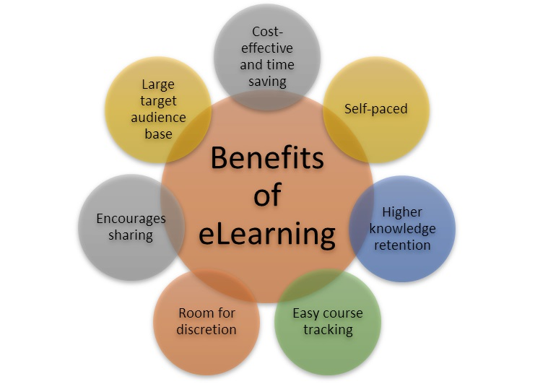
benefit of learning computer
With solid computer skills, you can automate routine tasks, analyze data more effectively, and communicate with colleagues more effectively

Slide 4
How many type of computer learning systems are there in Barishal university ?
3 type of computer systems are present in barishal university
Basic fundamental
Python
Web development
Data base
Basic fundamental: to know basic function ,like,ppt ,word ,Excel
Python : to know computer programming language
Web development :to know web page development ,web deign ,web sheet create etc

Slide 5
Percentage

Slide 6
A table about 47 batch student and their performance in basic fundamental
Student name | Pptx | Word file | Excel
Nabila | 98% | 80% | 60%
Ira | 97% | 81% | 55%
Tania | 98% | 70% | 62%
Faria | 96% | 85% | 65%
Ishita | 95% | 82% | 63%
Conclusion
In short, learning computers equips students with skills that are not just useful but essential in navigating the modern world, academically, professionally, and personally.

